Slide 1
LLMs for the Legal Domain
Saptarshi Ghosh
Department of CSE
Indian Institute of Technology Kharagpur
http://cse.iitkgp.ac.in/~saptarshi

Slide 2
Many types of legal documents
Statutes, e.g., Acts, Sections
First Information Reports (FIR)
Docs generated during a case, intermediate orders, …
Case judgements (generated at the end of a case)
Contracts, MoUs
Patents
Law reports
… any many more

Slide 3
Many types of legal documents
Statutes, e.g., Acts, Sections
First Information Reports (FIR)
Docs generated during a case, intermediate orders, …
Case judgements (generated at the end of a case)
Contracts, MoUs
Patents
Law reports
… any many more
Focus of this talk
Publicly available for many countries
Lot of prior research

Slide 4
Statutes
Laws are usually encoded in “Acts”
Road Traffic Act, 1961 – Ireland
Immigration and Asylum Act, 1999 – UK
European Convention on Human Rights (ECHR), 1950 – EU
Indian Penal Code (IPC), 1860 - India
Homeland Security Act, 2002 – USA
New laws are formed regularly
Older laws are extended / amended

Slide 5
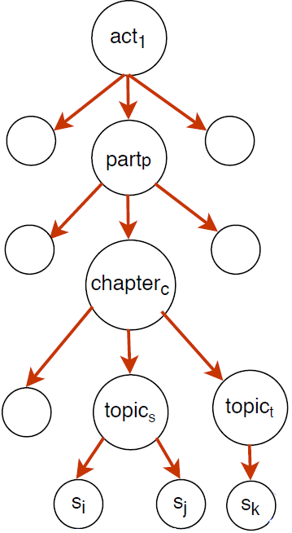
Statutes
Acts usually divided into sub-parts
Parts, Chapters, Topics, Sections
A tree-like hierarchy
Lowest level – Sections / Articles
Similar sections grouped under a topic
Similar topics grouped under a chapter
…

Slide 6
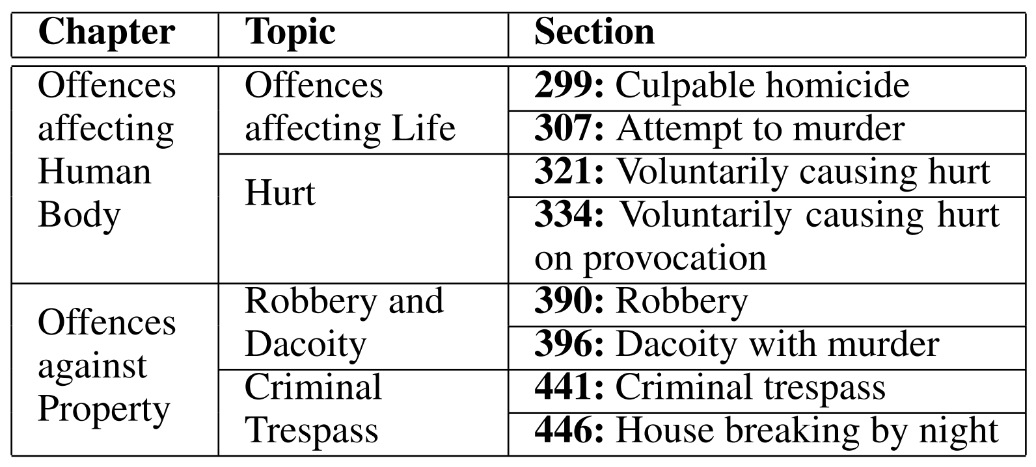
Example: Indian Penal Code (IPC)
Collection of statutes that deal with major types of crimes in India
Divided into Chapters, Topics, Sections
Similar sections grouped under a topic
Similar topics grouped under a chapter

Slide 7
Court case judgements
The final judgement pronounced by a Court of Law at the end of a case
Contains metadata (preamble) and the main judgement text
Judgements by important courts usually publicly available, particularly in Common Law jurisdictions (caselaw)
https://www.echr.coe.int/Pages/home.aspx?p=caselaw&c - ECHR
https://main.sci.gov.in/judgments - India
https://www.supremecourt.uk/decided-cases/ - UK

Slide 8
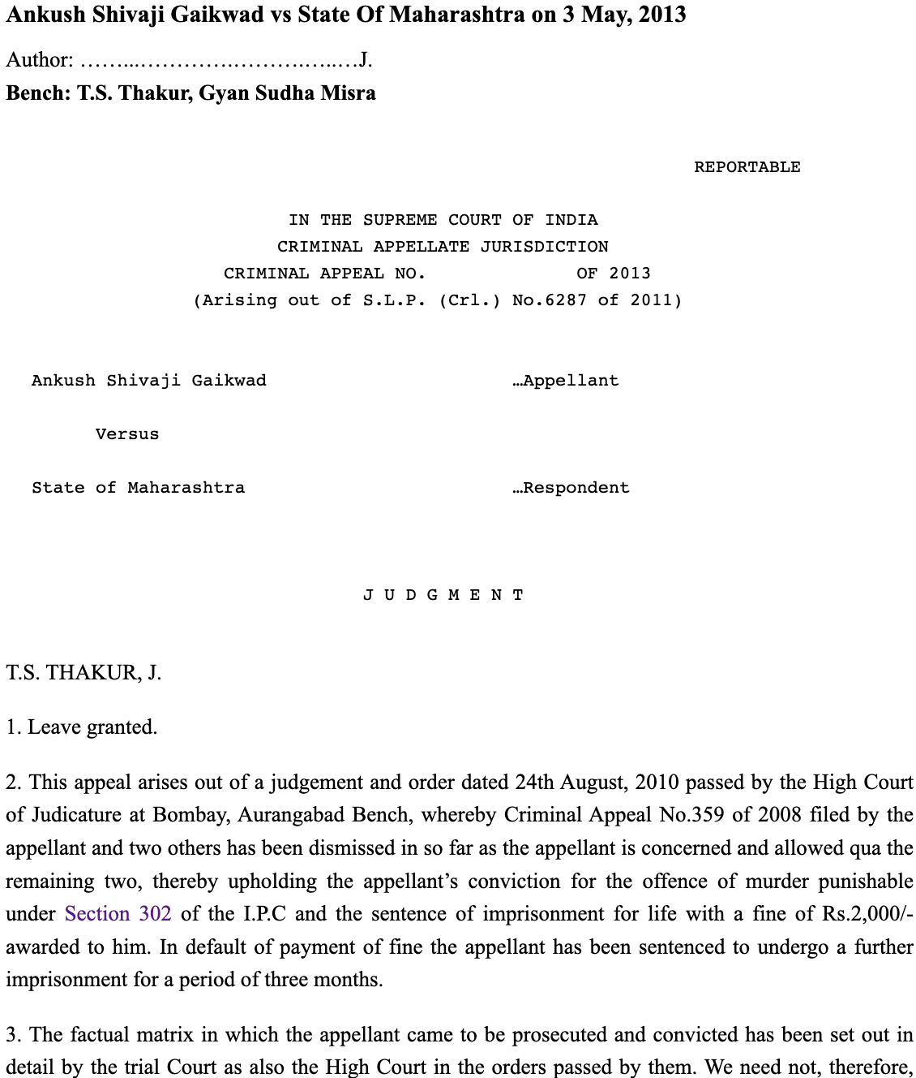
A case judgement from INSC
Decided by the Supreme Court of India on 3 May 2013
Metadata / preamble
Decided by which court
Date on which judgement was pronounced
The contending parties (Appellant vs. Respondent)
Name of the judge / bench
Sometimes, names of lawyers representing the two parties

Slide 9
The main text of a case judgement contains:
Facts: chronology of events that led to filing the case
Ruling by Lower Court: judgements given by lower Courts
Arguments: arguments of the contending parties
Statute citations: citations to relevant laws / statutes
Precedent citations: citations to prior cases
Ratio of the decision: rationale of the Court for the final ruling
Final Judgement: conclusion of the Court
Rhetorical segments

Slide 10
Challenges in ML / NLP over legal documents

Slide 11
Length of documents
Very long documents
Tens to hundreds of pages
Avg #words in Indian Supreme Court case judgements: 4.3K
Avg #words in UK Supreme Court case judgements: 14.3K
Problem in applying neural models
Legal docs often much longer than news articles, research papers, … over which neural models have been designed
Most recent neural models cannot take a full legal document as input

Slide 12
Complexity of text
Lengthy and complex sentences
Non-standard ways of writing, frequent use of abbreviations
Even identifying the end of sentences is challenging
[Sentence boundary detection in legal text, Natural Legal Language Processing Workshop 2019]

Slide 13
Complexity of text
Lengthy and complex sentences
Non-standard ways of writing, frequent use of abbreviations
Even identifying the end of sentences is challenging
[Sentence boundary detection in legal text, Natural Legal Language Processing Workshop 2019]
This Court in Indian Petrochemicals Corporation Ltd. & Anr. vs. Shramik Sena & Ors., 1999(6), referred to the decisions in Parimal Chandra Rahas case, Reserve Bank of India vs. Workmen, 1996, and M.M.R. Khan vs. Union of India, 1990, and held that the workmen of a statutory canteen, as in the present case, would be workmen of an establishment for the purposes of the Act only and not for other purposes.
[71 words]

Slide 14
Standard NLP tools do not usually work well on legal text
E.g., standard Named Entity Recognizers (Stanford / Spacy) often incorrect
“Life Insurance Corporation, India” Life : PER, Insurance Corporation : ORG, India : LOC
Example using Stanford NER
Example using Spacy NER
missed

Slide 15
Wide variation in style of writing
Significant variations in
Writing style and document structure
Lack of standard notations / terminologies
These can vary widely from one country to another, or even between different courts in the same country
E.g., summarization methods designed for documents of one country do not work well on documents from other countries [Bhattacharya et al. ECIR 2019]
Legal documents of some countries are particularly difficult for text analytics

Slide 16
Example case
United Kingdom Supreme Court
The Manchester Ship Canal Company Ltd and another (Respondents) v United Utilities Water Plc (Appellant)

Slide 18
Example Case
Supreme Court of India
Subimal Sarkar v Sachindra Nath Mondal and others, 2003

Slide 19
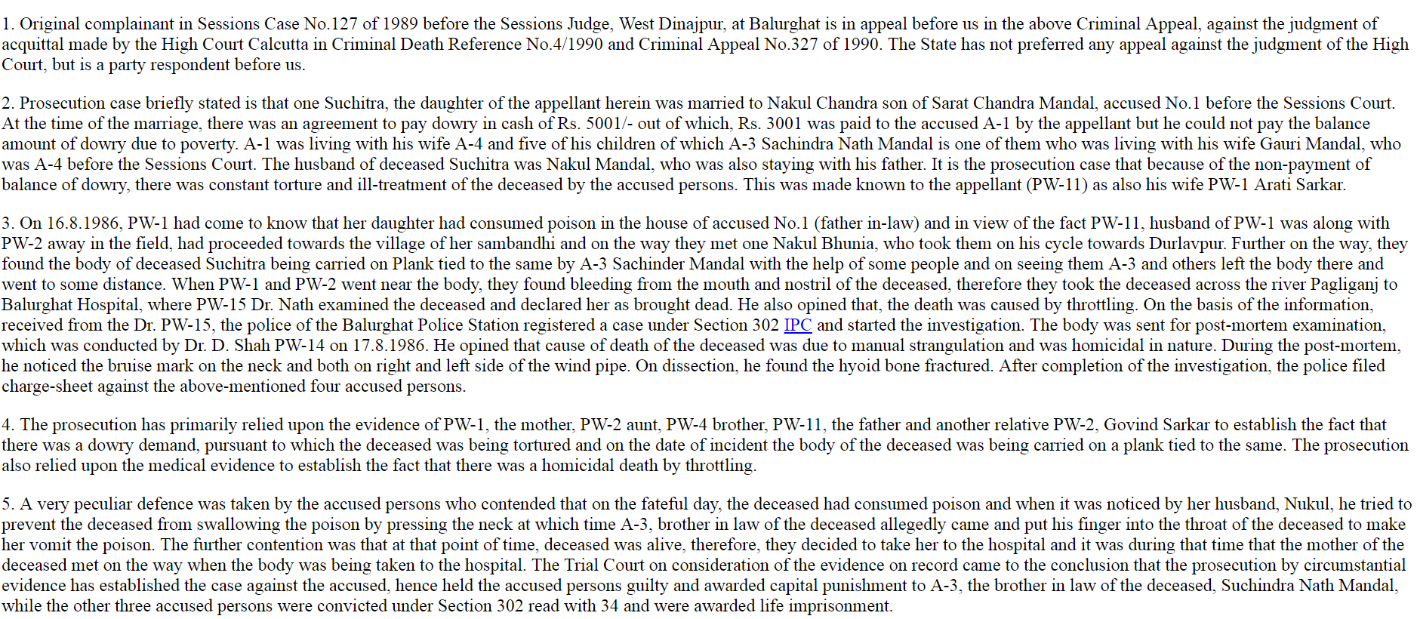

Slide 20
No headings or divisions
100+ pages of unstructured continuous text
Where are the Legal Issues ?
Where are the Arguments ?

Slide 21
Expensive to build large-scale datasets
Difficult to create large datasets required for supervised NLP/IR methods
Requires annotators having expertise in Law: expensive, time-consuming
My research group has developed the first Law-AI datasets for Indian judiciary for several Law-AI problems

Slide 22
Research problems

Slide 23
Popular research problems
Rhetorical labelling / semantic segmentation of case judgements
Retrieval of relevant precedents
Legal judgement prediction from given facts
Summarization of legal documents
Legal Statute Identification: Identifying relevant statutes from given facts
Legal citation network analysis
Training language models specific to the Law domain
Studying ethical issues of applying AI in the legal domain
Improving explainability of AI models in the legal domain
… and many more

Slide 24
Popular research problems
Rhetorical labelling / semantic segmentation of case judgements
Retrieval of relevant precedents
Legal judgement prediction from given facts
Summarization of legal documents
Legal Statute Identification: Identifying relevant statutes from given facts
Legal citation network analysis
Training language models specific to the Law domain
Studying ethical issues of applying AI in the legal domain
Improving explainability of AI models in the legal domain
… and many more

Slide 25
Case judgement summarization

Slide 26
Why summarize legal case judgements?
Law practitioners have to go through hundreds of legal case judgements
Important to identify precedents - prior cases that are relevant to an ongoing court case
Lengthy, unstructured, dense legal text → Reading the full documents is time-consuming even for Law practitioners

Slide 27
Challenges in summarizing legal case judgements
Very few datasets available for training legal summarization models
Expensive to get reference summaries written by Law experts
Documents are lengthy (thousands of words) → cannot be easily handled by most abstractive summarization models

Slide 28
Datasets for case judgement summarization
7,130 Indian Supreme Court case judgements and abstractive summaries
Average #words in documents: 4,378
Average compression ratio: 0.24
793 UK Supreme Court case judgements and abstractive summaries
Average #words in documents: 14,296
Average compression ratio: 0.11
50 Indian Supreme Court case judgements and extractive summaries
Average #words in documents: 4,378
Average compression ratio: 0.31
IN-Abs
UK-Abs
IN-Ext
Dataset | # Train docs | # Test docs
IN-Abs | 7,030 | 100
UK-Abs | 693 | 100
All datasets available at https://github.com/Law-AI/summarization

Slide 29
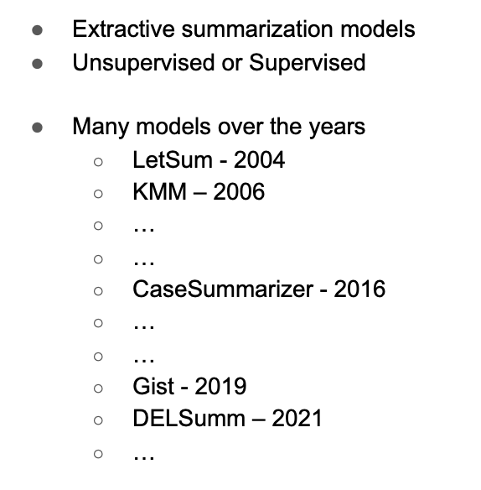
Many years of research on case judgement summarization
● Abstractive summarization models
● Said to generate more ‘coherent’ and ‘natural’ summaries
● Mostly supervised
● Domain-specific pre-trained models
Legal Pegasus – 2021
Legal LED – 2021
● General-domain LLMs
ChatGPT - 2022
Davinci - 2022

Slide 30
Extractive Text Summarization Algorithms
Domain Independent
Legal domain-specific
Supervised
Unsupervised
Supervised
Unsupervised
SummaRuNNer
BertSum-Ext
… and many others
LexRank
LSA
Luhn
Reduction
PacSumm
… and many others
Gist
CaseSummarizer
LetSum
KMM
MMR

Slide 31
Several abstractive summarization models
Pointer Generator
BERTSum-Abs
BART
Pegasus
BigBird
Longformer
… and others
Pre-trained versions – usually trained over news summarization datasets
Fine-tuned versions – fine-tuning over legal (doc, summary) pairs likely to yield better results

Slide 32
Several abstractive summarization models
Pointer Generator
BERTSum-Abs
BART
Pegasus
BigBird
Longformer
… and others
Pre-trained versions – usually trained over news summarization datasets
Fine-tuned versions – fine-tuning over legal (doc, summary) pairs likely to yield better results
Legal-Pegasus – https://huggingface.co/nsi319/legal-pegasus
Legal-Longformer - https://huggingface.co/nsi319/legal-led-base-16384
Already fine-tuned over legal summarization data (litigation releases and complaints from US courts)

Slide 33
Main challenge in applying abstractive models on legal docs
Limit on the number of input tokens
Many case docs do not fit in any of these models except Longformer
Several docs in UK-Abs do not fit fully even in Longformer
Model | Input Capacity
Pointer Generator | 400
BERTSum-Abs | 512
Legal-Pegasus | 1024
BART | 1024
BigBird | 4*1024
ChatGPT | 4*1024
Longformer | 16*1024
Dataset | Avg #words per doc
IN-Abs | 4,378
UK-Abs | 14,296

Slide 34
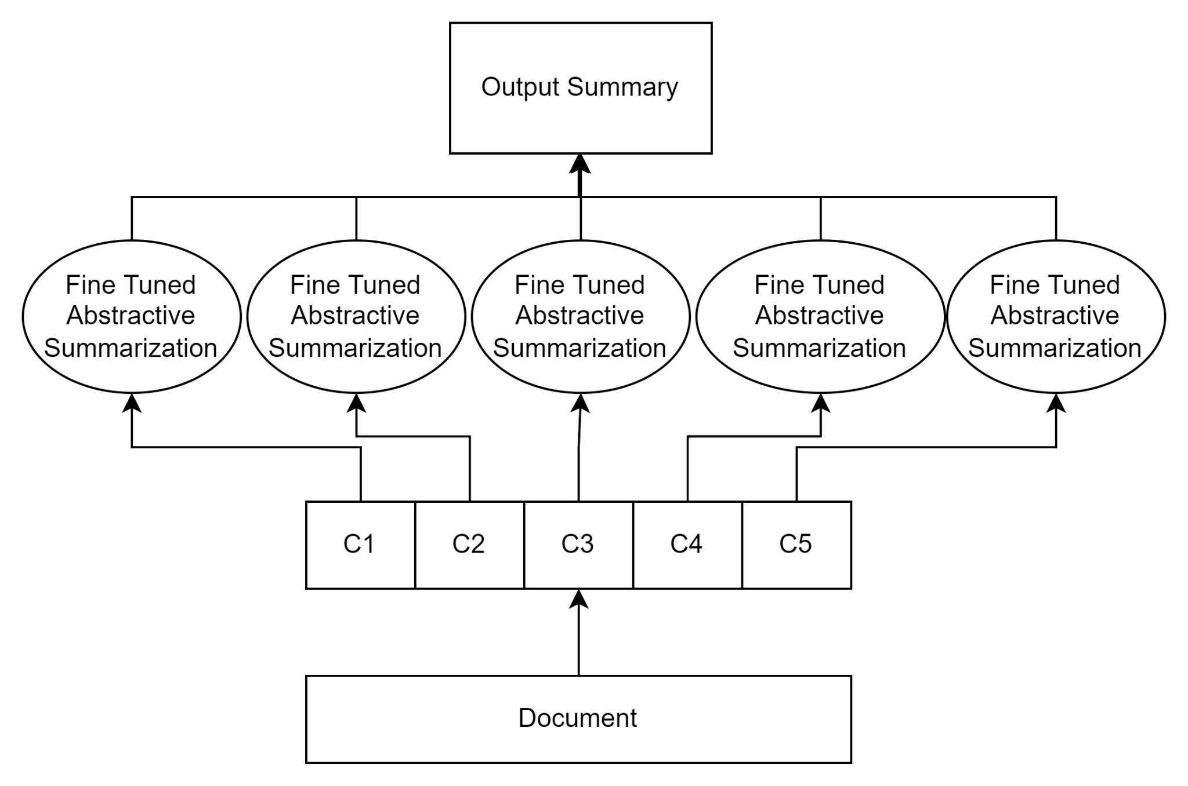
Solution: chunking with fine-tuning over legal data
Challenges:
How to get chunk-summary pairs for fine-tuning such models?
Loss of information across chunks

Slide 35
Summarization performance
Extractive models trained over legal data
vs.
Pre-trained abstractive models fine-tuned over legal data
Results on IN-Abs dataset
 | ROUGE-1 F | ROUGE-2 F | ROUGE-L F
Gist (Extractive) | 0.471 | 0.238 | 0.308
SummaRuNNer (Extractive) | 0.493 | 0.255 | 0.274
BART (Abstractive) | 0.495 | 0.249 | 0.330
Legal-Pegasus (Abstractive) | 0.488 | 0.252 | 0.341
Abstractive models often perform better than extractive models in terms of standard metrics

Slide 36
Many years of research on case judgement summarization
● Abstractive summarization models
● Said to generate more ‘coherent’ and ‘natural’ summaries
● Mostly supervised
● Domain-specific pre-trained models
Legal Pegasus – 2021
Legal LED – 2021
● General-domain LLMs
ChatGPT - 2022
Davinci - 2022

Slide 37
How ready are the pre-trained abstractive summarization models and the LLMs that are available today,
for case judgment summarization?
Study conducted in Feb-Mar 2023

Slide 38
Experiments on the IN-Abs dataset
● 7,130 Indian Supreme Court case judgements and abstractive summaries
○ Average #words in documents: 4,378
○ Average compression ratio: 0.19
Dataset | # docs | Used for
Train set | 7,030 | Training supervised models Fine-tuning pre-trained models
Test set | 100 | Evaluating all models

Slide 39
Using general-domain LLMs for case summarization
● Text-Davinci-003 (Davinci) – 175B parameters
● Turbo-GPT-3.5 (ChatGPT) – 154B parameters
● For either LLM, we try two variations with different prompts
tldr: Prompt: “<text to summarize> Tl;Dr”.
summ: Prompt: “<text to summarize> Summarize the document in <XX> words”

Slide 40
Using general-domain LLMs for case summarization
● ChatGPT and Davinci restrict the input length
○ Max 4,096 tokens for (prompt + generated text)
○ 1 token ~ 4 English characters
● Divide document into chunks; summarize each chunk individually; append chunk summaries to form final summary
● Tried with chunk sizes of 1,024 and 2,048 – similar trends w.r.t. metric values
● Results reported considering chunk size 1,024

Slide 41
Using general-domain LLMs for case summarization
summ: Prompt: “<text to summarize> Summarize the document in <XX> words”
XX: target summary length for a chunk of 1,024 words:
gold-std summary length x 1024
document length
Limitation: inherently assumes all chunks / parts of a judgement to have similar importance

Slide 42
Comparative results
LLMs achieve comparable summarization performance with extractive models
Domain-specific pre-trained abstractive models (e.g., LegLED fine-tuned over Indian legal documents) perform better than both LLMs and extractive models
However, summaries generated by abstractive models and LLMs often contain inconsistencies and hallucinations

Slide 43
Comparative results
LLMs achieve comparable summarization performance with extractive models
Domain-specific pre-trained abstractive models (e.g., LegLED fine-tuned over Indian legal documents) perform better than both LLMs and extractive models
However, summaries generated by abstractive models and LLMs often contain inconsistencies and hallucinations
What type of consistency errors / hallucinations occur in the summaries by LLMs and abstractive models?

Slide 44
Examples of consistency errors in summaries
Summarization Model | Extract from summary showing error | Explanation of error
LegLED | The phrase “regulated by usage” in section 6(9) of the MadrasHereditary succession is succession by the heir to the deceased under the law … | The name of the Act has been left incomplete and the word “Madras” has been merged with the next sentence.
LegLED | On March 31, 1965, the Honorable M.K. Ramaswami of the Madras High Court granted the SEC’s request for … | Actual name of the judge is ‘V. Ramaswami’ (and not ‘M.K. Ramaswami’ as stated in the summary). Whereas, ‘M.K. Ramamurthi’ is one of the lawyers representing the appellant. The summarization model has confused between the two names.
Examples from the Indian Supreme Court judgement indiankanoon.org/doc/1722864/

Slide 45
Examples of consistency errors in summaries
Summarization Model | Extract from summary showing error | Explanation of error
davinci-summ | The language used, Deoria, praying that the proceedings before the Nyaya Panchayat and its order dated … | As per the main document, ”Deoria” is the name of a place, not the name of a language
chatgpt-summ | The appellants, consisting of R Chari, M K Ramamurthi, Vineet Kumar, and Shyamala Pappu, were found guilty of contempt of court and each sentenced ... | These names are actually the lawyers who represented the appellants, not the appellants themselves. The main document states “A. S. R. Chari, M. K. Ramamurthi, Vineet Kumar and Shyamala Pappu, for the appellants”.
LegLED | ... violating the antifraud provisions of Section 17(a) of the Securities Act of 1933, Section 10(b) of the Securities Exchange Act of 1934 and Rule 10b-5 thereunder, ... | Hallucinations - the “Securities Act” and “Securities Exchange Act” are Acts of the USA and are totally unrelated to the source document (an Indian case)
Examples from the Indian Supreme Court judgement http://indiankanoon.org/doc/1234444/

Slide 46
Examples of consistency errors in summaries
Summarization Model | Extract from summary showing error | Explanation of error
LegLED-IN | The Court was right in holding that the Court was wrong in holding that it was not necessary … | This is a case heard in the Supreme Court of India, and is an appeal against a decision of the Bombay High Court. Hence two courts are involved, but it is not clear which court is referred to by which occurrence of the word ‘court’.
LegLED | On September 27, 2019, the U.S. District Court for the Southern District of New York entered a final judgment against Daula- tram Rameshwarlal, a firm registered under the Indian Partnership Act, and Daulatram Rameshwarlal, a registered dealer under the Indian Partnership Act, … | • The ‘U.S. District court of New York’ is hallucinated. • Year ‘2019’ is hallucinated (case is of 1961) • The model did not understand that the same entity ‘Daulatram Rameshwarlal’ is referred to both as a ‘firm’ and a ‘registered dealer’
Examples from the Indian Supreme Court judgement indiankanoon.org/doc/27285/

Slide 47
Multilingual summarization of Indian Case Judgements

Slide 48
What kind of summarization is required in India?
Due to historical reasons, most judgements in India written in complex English
A large majority of India’s population is not proficient in the English language
Summarize English judgements in Indian languages → improve access to justice and legal knowledge, especially among financially weaker sections

Slide 49
Dataset for cross-lingual summarization of Indian legal docs
MILDSum (Multilingual Indian Legal Document Summarization) – first dataset addressing cross-lingual summarization of Indian case judgements
Collected from LiveLaw – widely used by Indian law practitioners
English version: https://www.livelaw.in
Hindi version: https://hindi.livelaw.in
LiveLaw publishes concise reports / articles summarizing important Indian case judgements in both English and Hindi, drafted by Law practitioners

Slide 50
Dataset for cross-lingual summarization of Indian legal docs
3,122 judgements in English and
Their abstractive summaries in English and Hindi
Average #words in a document: 4,696
Average #words in English summary: 724
Average #words in Hindi summary: 695
MILDSum dataset
# Train docs | # Val docs | # Test docs
2185 | 469 | 468

Slide 51
How do LLMs performs in multi-lingual summarization?
Tried GPT-3.5 and GPT-4
GPT-4 generates good English summaries – BERTscore similar to the best traditional models
But GPT-4 performs poorly in cross-lingual summarization
When prompted to generate a summary in Hindi and given the English document as input, generates a mixture of English and Hindi
Even, including “Devanagari script” in the prompt does not help

Slide 52
Details in our papers
A comparative study of summarization algorithms applied to legal case judgements, European Conference on Information Retrieval (ECIR) 2019
Incorporating Domain Knowledge for Extractive Summarization of Legal Case Documents, Int’l Conference on AI and Law (ICAIL) 2021 [Best Student Paper]
Legal Case Document Summarization: Extractive and Abstractive Methods and their Evaluation, AACL-IJCNLP 2022
How Ready are Pretrained Abstractive Models and LLMs for Legal Case Judgement Summarization?, LegalAIIA Workshop, 2023
MILDSum: A Novel Benchmark Dataset for Multilingual Summarization of Indian Legal Case Judgments, EMNLP 2023
Datasets and codes: https://github.com/Law-AI/summarization

Slide 53
Legal Statute Identification

Slide 54
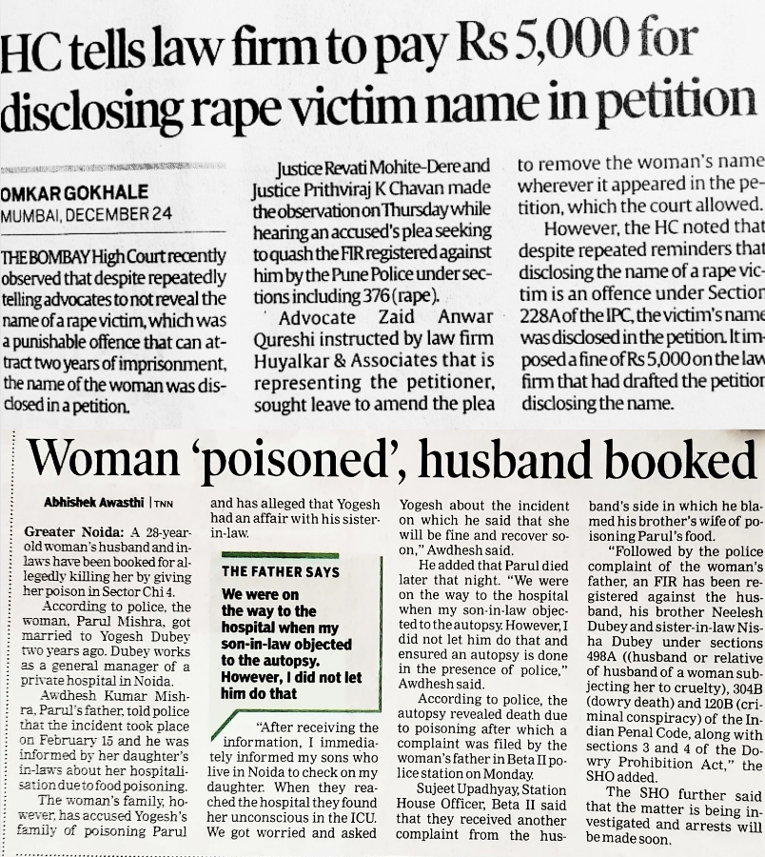
Introduction
Legal Statute
A codified article of law, enacted by the Legislature
Examples
Indian Penal Code (IPC)
Dowry Act
Sec. 376, 228A, 498A, 120B of IPC
Sec. 3, 4 of Dowry Act

Slide 55
“…On the fateful day at about 9.30 a.m. deceased accompanied by Mansingh (PW 4) and Gulabsingh (PW 7) was going from his village Talod to Alote. The accused persons were hiding behind bushes on the road near village Gharola. They were armed with lathies and farsies. When the deceased and the aforesaid two persons reached near the Khakhra, the respondents surrounded them and started attacking the deceased with weapons with which they were armed. His nose was cut. PWs. 4 and 7 tried to intervene, but they were also attacked by the accused persons as a result of which they also received injuries. The two witness rushed to the police station where PW 4 lodged the FIR (Exhibit P-10). The deceased in injured condition was taken to the hospital, and later he succumbed to the injuries. Post-mortem was conducted and large number of injuries were found on his body…”
Introduction
Legal Facts / Evidence
What actually happened at the scene of the crime, as narrated by witnesses / complainant

Slide 56
“…On the fateful day at about 9.30 a.m. deceased accompanied by Mansingh (PW 4) and Gulabsingh (PW 7) was going from his village Talod to Alote. The accused persons were hiding behind bushes on the road near village Gharola. They were armed with lathies and farsies. When the deceased and the aforesaid two persons reached near the Khakhra, the respondents surrounded them and started attacking the deceased with weapons with which they were armed. His nose was cut. PWs. 4 and 7 tried to intervene, but they were also attacked by the accused persons as a result of which they also received injuries. The two witness rushed to the police station where PW 4 lodged the FIR (Exhibit P-10). The deceased in injured condition was taken to the hospital, and later he succumbed to the injuries. Post-mortem was conducted and large number of injuries were found on his body…”
Introduction
Legal Statute Identification
Given the facts of the situation, identify the legal statutes which apply
Section 324 of the Indian Penal Code: Voluntarily Causing Hurt using Dangerous Weapons or Means

Slide 57
“…On the fateful day at about 9.30 a.m. deceased accompanied by Mansingh (PW 4) and Gulabsingh (PW 7) was going from his village Talod to Alote. The accused persons were hiding behind bushes on the road near village Gharola. They were armed with lathies and farsies. When the deceased and the aforesaid two persons reached near the Khakhra, the respondents surrounded them and started attacking the deceased with weapons with which they were armed. His nose was cut. PWs. 4 and 7 tried to intervene, but they were also attacked by the accused persons as a result of which they also received injuries. The two witness rushed to the police station where PW 4 lodged the FIR (Exhibit P-10). The deceased in injured condition was taken to the hospital, and later he succumbed to the injuries. Post-mortem was conducted and large number of injuries were found on his body…”
Introduction
Legal Statute Identification
Given the facts of the situation, identify the legal statutes which apply
Section 302 of the Indian Penal Code: Punishment for Murder

Slide 58
Introduction
(ID)
Section 306 of the IPC
(Title)
Abetment of Suicide
(Body)
If any person commits suicide, whoever abets the commission of such suicide, shall be punished with imprisonment of either description for a term which may extend to ten years, and shall also be liable to fine
Legal Statute has 3 parts
ID/Code: Section or Article number
Title: Short description
Body: Full description

Slide 59
ILSI : An Indian dataset for Legal Statute Identification
The IPC is divided into Chapters, Topics, Sections
The most frequently cited 100 Sections are the labels in ILSI
Evaluation of models: Micro-averaged Precision, Recall, F1

Slide 60
An example from the ILSI dataset
On the fateful day at about 9.30 a.m. deceased accompanied by Mansingh (PW 4) and Gulabsingh (PW 7) was going from his village Talod to Alote. The accused persons were hiding behind bushes on the road near village Gharola. They were armed with lathies and farsies. When the deceased and the aforesaid two persons reached near the Khakhra, the respondents surrounded them and started attacking the deceased with weapons with which they were armed. His nose was cut. PWs. 4 and 7 tried to intervene, but they were also attacked by the accused persons as a result of which they also received injuries. The two witness rushed to the police station where PW 4 lodged the FIR (Exhibit P-10). The deceased in injured condition was taken to the hospital, and later he succumbed to the injuries. Post-mortem was conducted and large number of injuries were found on his body. During investigation the alleged weapons of the assailants were seized. After investigation charge sheet was placed.
Facts of
a legal situation
Section 324 of IPC: Voluntarily causing hurt by dangerous weapons or means
Relevant statutes
Section 302 of IPC: Punishment for Murder

Slide 61
Approaches to LSI
Approaches that encode facts only
Approaches that encode both facts and statute texts for matching
Approaches that generate relevant statutes
1
2
3

Slide 62
Approaches to LSI
Approaches that encode facts only
Most intuitive way
Use a neural encoder to convert fact text to vector representations (embeddings)
Pass to a linear classifier
Neural Encoders: Hier-BERT, Longformer
Considers each statute as just a label (same as 0, 1, 2, …) without any label semantics
1

Slide 63
Approaches to LSI
Approaches that encode both facts and statute texts for matching
Real-world setting: Lawyers look at both the facts and the statute text / descriptions
Neural encoder converts both fact and statute texts to embeddings
Additional layers (e.g., attention, GNN) for modeling relationships between fact and statute embeddings
Examples: LADAN (Xu et al., 2020), LeSICiN (Paul et al., 2022)
2

Slide 64
Approaches to LSI
Approaches that generate relevant statutes
Modern LLMs can utilize their understanding of language to generate text
Many LLMs (GPT, LLaMa) already have knowledge of many statutes of many countries, including India
Provide the facts to the LLM and ask it to generate the IDs / titles of relevant statutes
3

Slide 65
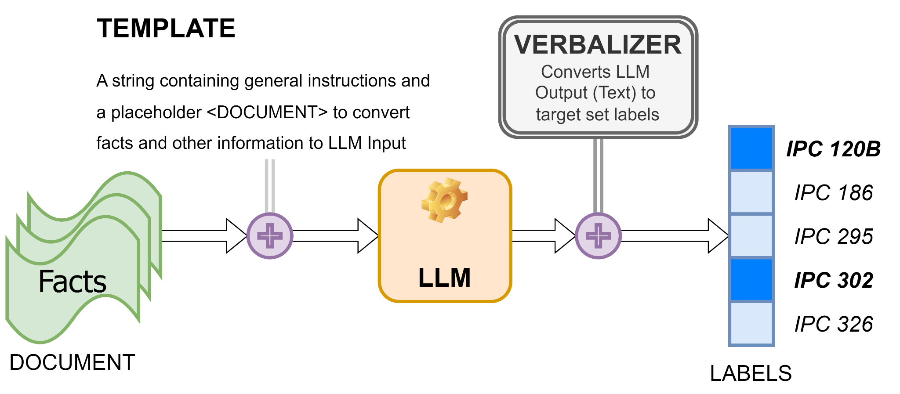
Text Generation using LLMs
General Pipeline for Prompting

Slide 66
Zero-Shot Prompting
Simplest setup
Just provide the instructions, and the facts
Since modern LLMs have are already conversant with IPC, no need to provide target statutes

Slide 67
GPT-4 PROMPT
SYSTEM: You are an intelligent Legal Statute Identification (LSI) system. You will be provided the the facts of an Indian court document. You need to output the Sections of the Indian Penal Code (IPC) and their corresponding titles which are possibly violated given the facts of the document. You should strictly adhere to the output format. Do not output anything else. It has been found out that on average, each Indian Court Document has may contain between 1 and 12 relevant statutes per document. Keep this in mind while finding out relevant statutes.
USER: Are you clear about your role?
ASSISTANT: Yes, I understand my role as an intelligent Legal Statute Identification (LSI) system. My task is to identify and output the IPC sections and their corresponding titles that may be violated provided the facts of the document. I will adhere strictly to the specified output format. Please provide me with the facts, and I will do my best to assist you.
USER: Output Format:
<Statute 1>
<Statute 2>
...
<Statute x>
Facts: <DOCUMENT>
The IPC statutes which may have been violated are :
ASSISTANT: <LLM OUTPUT>
Zero-Shot Prompting
Just provide instructions, and the facts
Since modern LLMs have are conversant with IPC

Slide 68
Zero-Shot Prompting
MODEL | m-PREC | m-REC | m-F1
Classification-based models (No Text Generation)
BEST | 32.83 | 28.48 | 28.78
Other | 25.69 | 18.55 | 20.39
Text Generation Using LLMs (Zero-Shot)
GPT-4 | 27.15 | 29.18 | 26.13
GPT-4 outperform many classification-based methods
Comes close to the best
Best recall for GPT-4

Slide 69
GPT-4 PROMPT
SYSTEM: You are an intelligent Legal Statute Identification (LSI) system. You will be provided the the facts of an Indian court document. In addition to this, I will give you a collection of Indian Penal Code (IPC) Statutes with their titles. From this collection, you need to output the Sections their corresponding titles which are possibly violated given the facts of the document. You should strictly adhere to the output format. Do not output anything else. Do not output IPC Sections which are not a part of this collection. It has been found out that on average, each Indian Court Document has between 1 to 12 relevant statutes per document. Keep this in mind while finding out relevant statutes.
USER: …
ASSISTANT: …
USER: Collection of IPC Sections and their titles:
Section 120B : Punishment of criminal conspiracy
Section 186 : Obstructing public servant in discharge of public functions
….
Output Format:
… (SAME) …
Facts: <DOCUMENT>
The IPC statutes which may have been violated are :
ASSISTANT: <LLM OUTPUT>
Zero-Shot Prompting (with Statutes)
Additionally, specify the IDs (Sec No. of IPC) of target set of statutes
Can also specify the titles of all target statutes

Slide 70
Zero-Shot Prompting (with Statutes)
MODEL | m-PREC | m-REC | m-F1
Classification-based models (No Text Generation)
BEST | 32.83 | 28.48 | 28.78
Other | 25.69 | 18.55 | 20.39
Text Generation Using LLMs (Zero-Shot)
GPT-4 | 27.15 | 29.18 | 26.13
Text Generation Using LLMs (Zero-Shot with Statutes)
GPT-4 | 26.08 | 32.28 | 26.24
GPT-4 performance m-F1 remains unchanged
Higher recall but lower precision

Slide 71
GPT-4 PROMPT
SYSTEM: You are an intelligent Legal Statute Identification (LSI) system. You will be provided the the facts of an Indian court document. You need to output the Sections of the Indian Penal Code ( IPC) and their corresponding titles which are possibly violated given the facts of the document. You should strictly adhere to the output format. Do not output anything else. It has been found out that on average, each Indian Court Document has may contain between 1 and 12 relevant statutes per document. Keep this in mind while finding out relevant statutes. To help you, I will give an example document and the output for that document. Go over the document and try to understand how statute identification is done. The output tells you the corrent way to output the statutes.
USER: …
ASSISTANT: …
USER: Output Format:
… (SAME) …
Example Facts: <TRAINING EXAMPLE FACTS>
Example Output: <TRAINING EXAMPLE GOLD-STANDARD STATUTES>
Facts: <DOCUMENT>
The IPC statutes which may have been violated are :
ASSISTANT:
One-shot Prompting
Add a training example (facts and relevant statutes) as part of the prompt
Helps the model learn from training data patterns in-context

Slide 72
One-Shot Prompting
MODEL | m-PREC | m-REC | m-F1
Classification-based models (No Text Generation)
BEST | 32.83 | 28.48 | 28.78
Other | 25.69 | 18.55 | 20.39
Text Generation Using LLMs (Zero-Shot)
GPT-4 | 27.15 | 29.18 | 26.13
Text Generation Using LLMs (One-Shot)
GPT-4 | 25.65 | 25.62 | 23.79
GPT-4 performance decreases sharply
Many target statutes, a single example could introduce bias
Models more likely to predict same statutes as the in-context example

Slide 73
An idea to improve LSI: only a small portion of the fact is relevant
On the fateful day at about 9.30 a.m. deceased accompanied by Mansingh (PW 4) and Gulabsingh (PW 7) was going from his village Talod to Alote. The accused persons were hiding behind bushes on the road near village Gharola. They were armed with lathies and farsies. When the deceased and the aforesaid two persons reached near the Khakhra, the respondents surrounded them and started attacking the deceased with weapons with which they were armed. His nose was cut. PWs. 4 and 7 tried to intervene, but they were also attacked by the accused persons as a result of which they also received injuries. The two witness rushed to the police station where PW 4 lodged the FIR (Exhibit P-10). The deceased in injured condition was taken to the hospital, and later he succumbed to the injuries. Post-mortem was conducted and large number of injuries were found on his body. During investigation the alleged weapons of the assailants were seized. After investigation charge sheet was placed.
Section 324 of IPC: Voluntarily causing hurt by dangerous weapons or means
Section 302 of IPC: Punishment for Murder

Slide 74
GPT-4 PROMPT
SYSTEM: You are an intelligent Legal Statute Identification (LSI) System. You will be provided the the facts of an Indian court document. From these facts you need to extract the sentences from the entire text which may indicate crimes under the Indian Penal Code (IPC). Also select those sentences which indicate preparation for such crimes and consequences of these crimes. You should output ALL such sentences which can even indirectly indicate such a crime, even in the slightest way possible. In a later stage, you might be asked to output the Indian Penal Code (IPC) statutes which might have been violated in each of the sentences you output now. For now, simply output the sentences which you think might indicate a crime. Follow the output format given to you. Do not give any justification. Do not output anything else except what is asked.
USER: …
ASSISTANT: …
USER: Output Format:
… (SAME) …
Facts: <DOCUMENT>
The sentences which indicate possible crimes are :
ASSISTANT: <LLM OUTPUT1>
Chain of Thought Prompting
Facts are known to be noisy, and only a small portion is relevant for LSI
First, ask the LLM to select the important parts from the facts
Can be considered an extractive summary from an LSI perspective

Slide 75
GPT-4 PROMPT
…
USER: Output Format:
… (SAME) …
Facts: <DOCUMENT>
The sentences which indicate possible crimes are :
ASSISTANT: <LLM OUTPUT1>
USER: For all these sentences which you have just output, you need to provide a list of IPC statutes for each sentence. Therefore, your output MUST contain the same number of lines as the number of lines in the output which you have just provided. For example, if your output contains a sentence such as:
\n\n
... and brutally murdered her in broad daylight …
\n\n
You must output something like:
\n\n
[IPC Section 302 (Punishment for Murder)
\n\n
Follow the format given above. Do not output anything else. No justification is required
ASSISTANT: <LLM OUTPUT2>
Chain of Thought Prompting
Pass the entire conversation (including Output1) to the LLM again
Ask the LLM to predict statutes as before, but now with the summarized facts as input

Slide 76
Chain of Thought Prompting (Example)
Learned counsel <ENTITY> the petitioners has submitted that the petitioners are National leaders of a recognized Political Party and the petitioner no.1 is presently the Chief Minister of N.C.T. Delhi.
The petitioner no.2 is Internationally acclaimed Poet.
The petitioners were having the permission <ENTITY> procession of Rally and prohibitory order under <SECTION> <ACT> and permission <ENTITY> procession <ENTITY> rally cannot run together.
It has also been submitted that the First Information Report does <ENTITY> constitute the offence as alleged and the charge-sheet has been filed in a mechanical way, upon which, the learned Judicial Magistrate has also <ENTITY> applied his mind and has taken cognizance.
It has also been submitted that to oblige the sitting Members of Parliament, the entire district administration and police force had caused impediment in election campaign of petitioner no.2 and have lodged various frivolous complaints.
The petitioners were always calm and peaceful during their campaign.
Heard learned counsel <ENTITY> the petitioners, learned Additional Government Advocate and perused the record
This petition under <SECTION> <ACT> has been filed with the prayer to quash the order dated 07.10.2016, passed by the learned Additional Chief Judicial Magistrate-VI, Court No.22, Sultanpur, by which, the application of the petitioner no.1 <ENTITY> exemption has been rejected, as well as the Charge Sheet No.87 of 2015 dated 24.06.2015 and the cognizance order dated 13.04.2016 passed in Criminal Case No.216 of 2016 relating to Case Crime No.367 of 2014, under <SECTION>, Police Station-Gauriganj, District-Sultanpur.
There are specific allegations against the petitioners that permission <ENTITY> road show/ procession was granted from Amethi to <ENTITY> upto <ENTITY>
The petitioners had parked their vehicles in the mid of road and started their campaign on the crossing.
The District Election Officer has <ENTITY> granted such permission.
Due to illegal act of the petitioners, there were problem of traffic jam.
It has also been mentioned in the First Information Report that Vehicle No. UP-30-T-7718 was having loudspeaker and it was <ENTITY> having <ENTITY> paper and when the driver was asked to go to police station, the petitioners' party workers opposed it and forcefully took away the vehicle, against which, the petitioners and their party workers used criminal force against the public servants from discharge of their duty.

Slide 77
Chain-of-Thought Prompting
MODEL | m-PREC | m-REC | m-F1
Classification-based models (No Text Generation)
BEST | 32.83 | 28.48 | 28.78
Other | 25.69 | 18.55 | 20.39
Text Generation Using LLMs (Zero-Shot)
GPT-4 | 27.15 | 29.18 | 26.13
Text Generation Using LLMs (Zero-Shot with Statutes)
GPT-4 | 26.08 | 32.28 | 26.24
Text Generation Using LLMs (CoT - Extractive)
GPT-4 | 25.08 | 33.78 | 26.47
GPT-4 performance does not change much (though recall improves quite a lot)
We have found several ways to improve Recall, but Precision goes down
Need to maintain a balance between P & R

Slide 78
Summary
Large Language Models need lot of improvement for the legal domain
Reported good performance on simpler applications, e.g., legal MCQs
But still lacking in more complex tasks involving legal reasoning, summarization, etc.
Several datasets and codes for challenging problems in Legal NLP
https://github.com/Law-AI/
Thank you. Questions / suggestions ?

Slide 79
Interested to work long-term in the domain?
NyayKosh: Multilingual Resources for AI-based Legal Analytics for India
Tech institutes Law Institutes
IIT Kharagpur RGSOIPL Kharagpur
IIT Kanpur WBNUJS Kolkata
IISER Kolkata
We will be hiring soon at all institutes !!

Slide 80
Looking for a challenging NLP problem right now?
https://sites.google.com/view/icpr24-csi/home

